Slide 1
We’re Better Together
NWA 2020 Virtual Conference
Tony Rice Nate Johnson
February 20, 2020
Snow forecasts

Slide 2
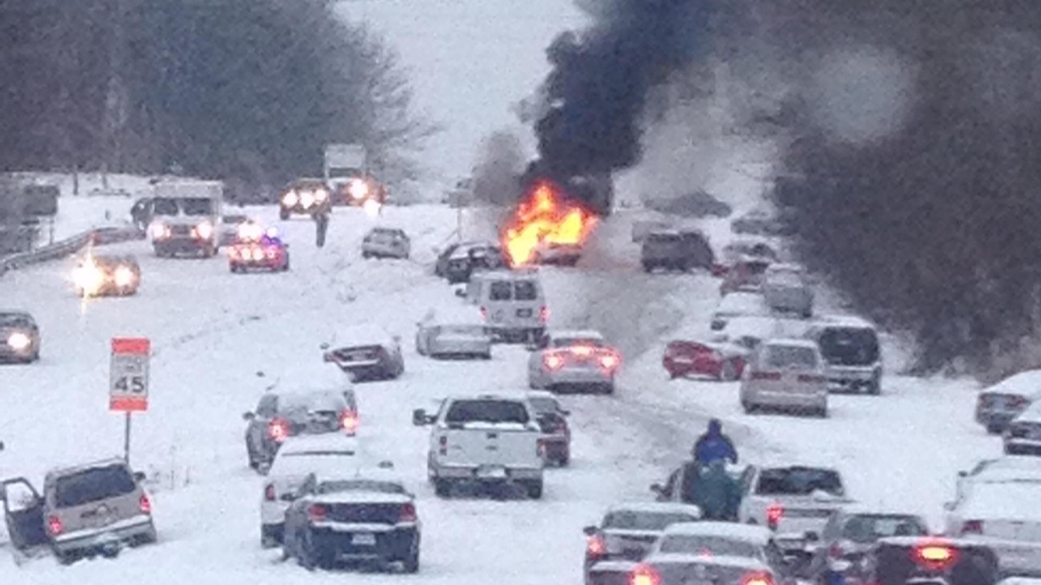
Photo: Lindsay Webb, WRAL

Slide 3
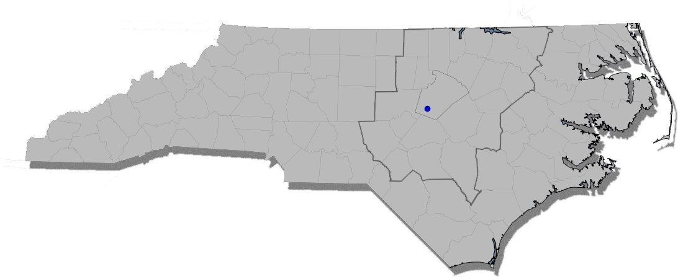
Forecast Evolution for Holly Springs, NC
 |  |  |  |  |  |  |  |  |  |  |  |  |  |  |  |  |  |  |  |  | average
2/19 10am |  | 3-6 |  | 3 |  | 2-4 |  | 2 |  | 1 | 2-3 | 2-4 | 1-3 |  |  | 1 | 1-2 |  | 2-4 |  | 2.3
2/19 6pm | 4-6 | 3-6 |  | 3 |  | 2-4 | 2-3 | 2 |  | 2-3 | 1-3 | 2-4 | 1-3 | 1-3 | 1-3 | 2-3 | 1-3 |  | 2-4 | 1-3 | 2.8
2/20 12:30pm | 4-6 | 2-5+ | 3-5 | 2-5 | 4 | 2-4 | 2-4 | 2-4 | 2-4 | 2-3 | 1-3 | 1-3 | 1-3 | 1-3 | 1-3 | 1-3 | 1-3 | 1-3 | 1-2 | 1-2 | 2.6

Slide 4
Ensemble Map
<1”
1-2”
2-3”
3+”

Slide 5
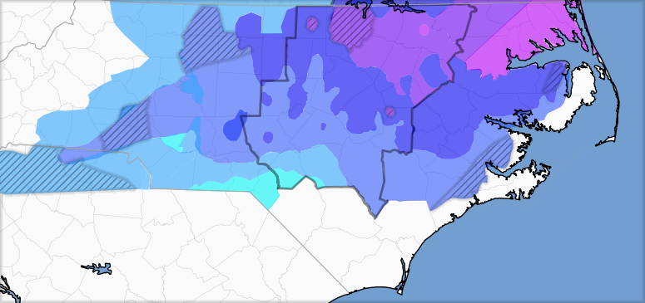
Snowfall Forecast Ensemble
Forecast consensus miss
Consensus across meteorologists in Raleigh-Durham market against spotter reported totals.
Data: WRAL, WTVD, WNCN, Spectrum News, NWS Raleigh
Data: WRAL, WTVD, WNCN, Spectrum News, NWS Raleigh

Slide 6
1 event, many color scales

Slide 7

Call to action
Evolve the message with the forecast
Several days out – possible impact (school, travel, power) Message: pay attention!
A few days out– increased confidence of nature, timing, and impact Message: think through how this affects you and your family
Last 24-36 hours – zeroing in on timing and impact Message: put plans into motion
Maps are the message
Consistent colors & ranges
Clear labeling
Lines & ranges matter (hard vs fuzzy)
Focus on the area you know best

Slide 8

https://github.com/rtphokie/RAHFeb2020SnowEvent
Tony Rice
Solar System Ambassador NASA/JPL
@rtphokie
tony@rtphokie.org
Nate Johnson
Director of Weather Operations NBC Universal Owned Stations
@nsj
Nate.Johnson@nbcuni.com

